Slide 1
LNHS PTSA Wednesday, August 17, 2022 6:30pm General Meeting & SAC Elections
Followed By
MEET THE PRINCIPAL
Q&A with Mrs. Nikki Campbell, LNHS Principal

Slide 2
LNHS PTSA Meeting Agenda August 17, 2022
Agenda:
Welcome/Confirm Quorum/FB Live Attendees
Meeting Called to Order by President
Introductions/Special Guests
Position Board Members
President Christal Feldman
1st VP - Membership Brenda Meadows
Treasurer Carrie Howard
Recording Secretary Gabriella Nguyen
Corresponding Secretary Sophia Rogers
Chairs
LWL Co-Advisors Suzanne Arnold & Tania Abreu
Finance Chair OPEN
Staff Appreciation Angie Garcia & Iris Metel
Fundraising Chair OPEN
Web Master Erika Remley
Staff Liaison Kari Grimm
Spirit Wear Chair Michelle Adamick
OLD BUSINESS
Approval of Past Minutes (May)
Review of Annual Financial Report
NEW BUSINESS
Vote on 2022-2023 Proposed Budget
Membership Updates
Spirit Wear Sales
Legacy Brick Campaign
Amazon Smile
Staff Appreciation
Learn with Lions
SAC Elections
Communication Updates
Next Meeting - Tuesday, September 20th
Meeting Adjourned by President
August Meeting Topic: MEET THE PRINCIPAL - Q&A

Slide 3
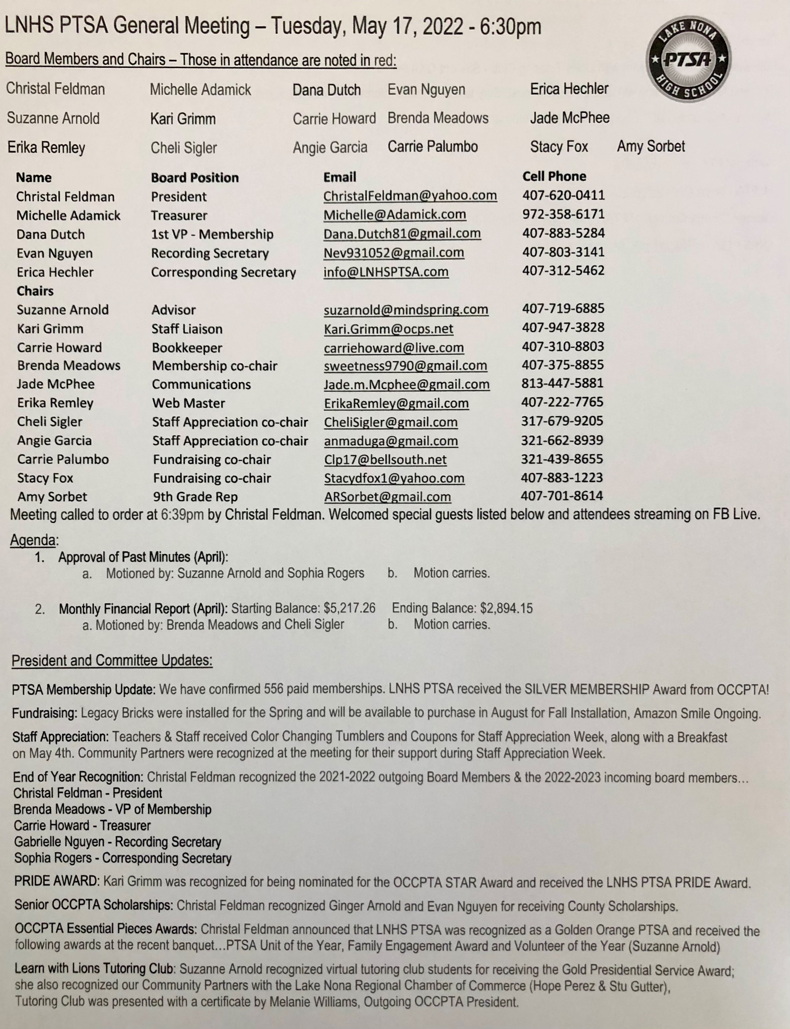
PAST MINUTES FOR APPROVAL May 17, 2022

Slide 4
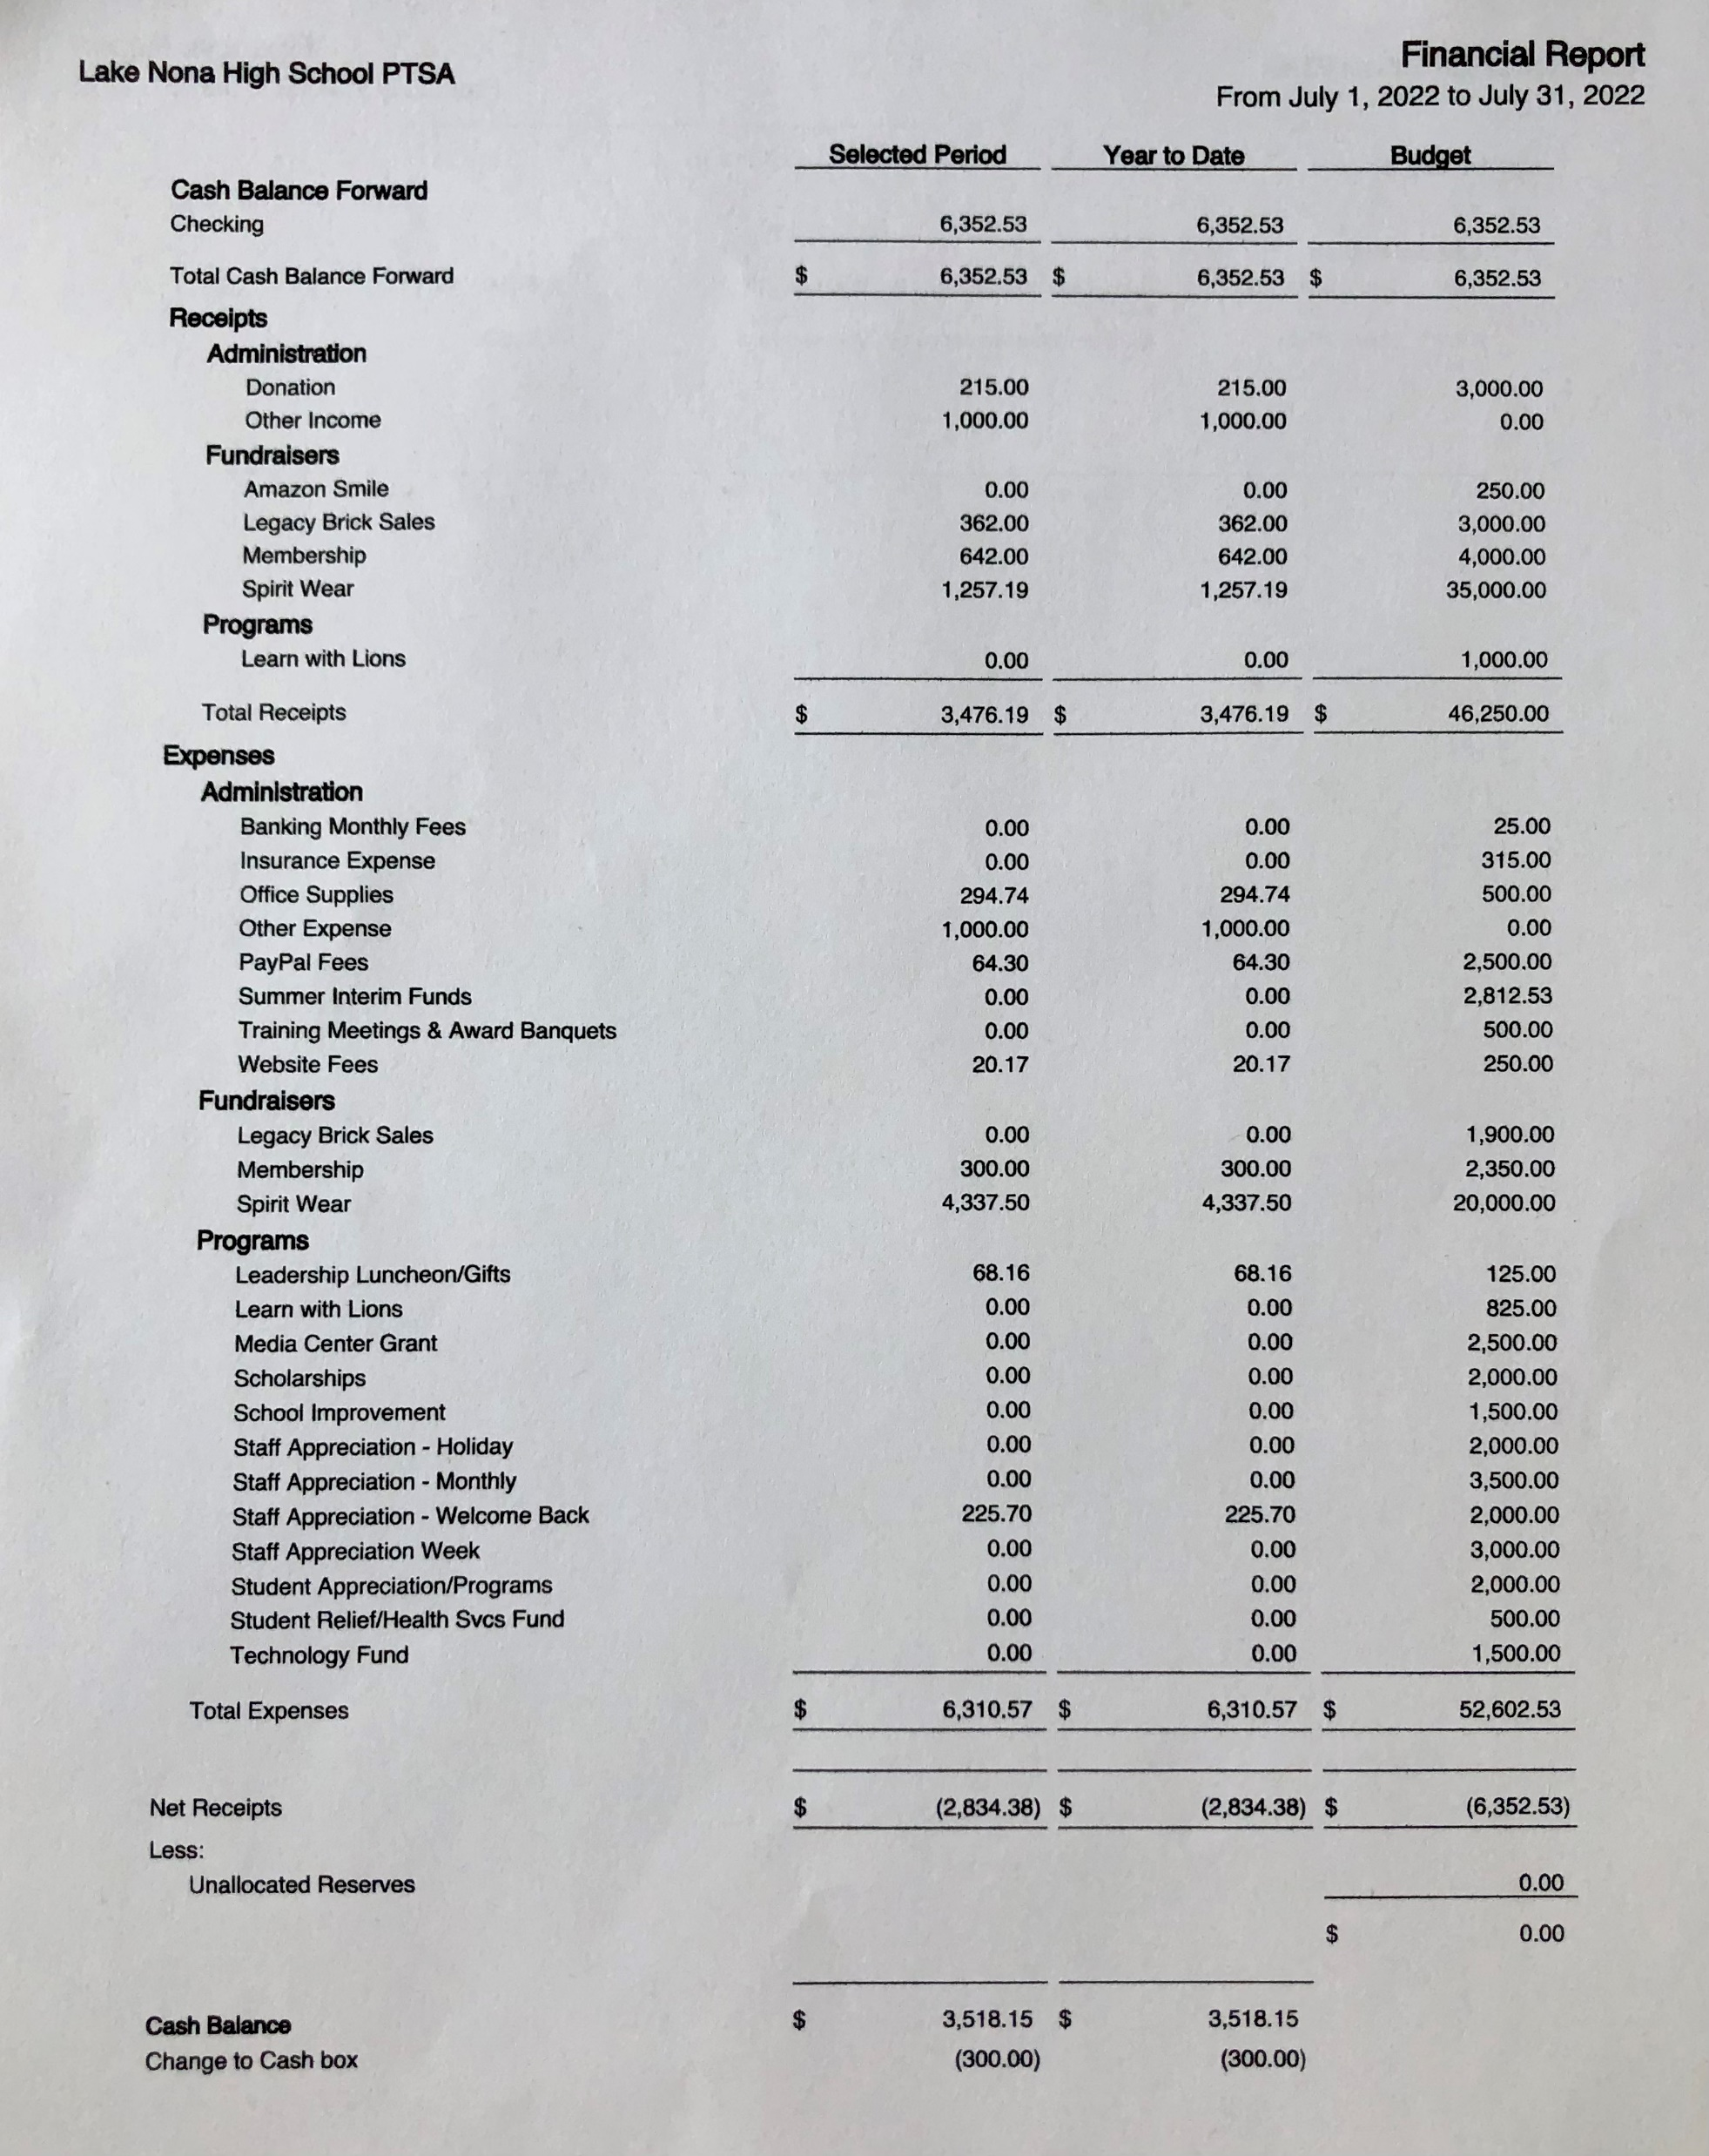
FINANCIAL REPORT FOR APPROVAL July 2022 Financial Report
Year to Date Summary 2021-2022 Audit Completed on July 8, 2022 Bank Statements and PTAez Balanced 2022-2023 Beginning Balance $6,352.53 (Switched Bank Accounts from Truist to Synovus)

Slide 5
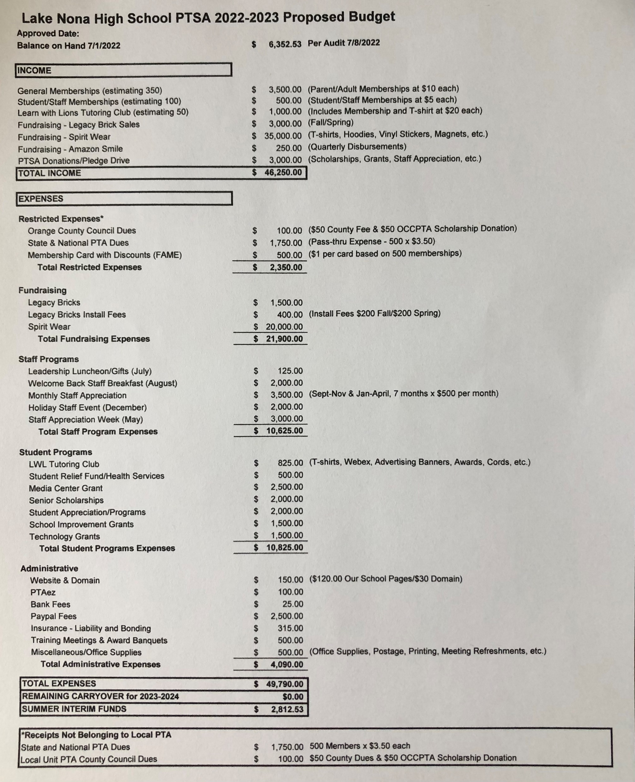
2022-2023
LNHS PTSA
PROPOSED BUDGET
FOR APPROVAL Annual Budget July 2022 - June 2023 Summary Beginning Balance - $6,352.53
Projected Income - $46,250.00
Projected Expenses - $49,790.00
Summer Interim Funds - $2,812.53

Slide 6
PTSA MEMBERSHIP Online Sales Started on July 16, 2022 July - Over 300 Memberships Received Currently Over 400 Memberships Received (Well OVER Halfway to Our Goal of 650!) Membership Options Parent/Adult - $10 Teachers & Staff - $5 Students - $5 (Includes Discount Card)

Slide 7
SPIRIT WEAR - Online Sales Started on July 16, 2022 - Raised OVER $2,500 and SOLD OUT of Hoodies at Return of the Pride - Projected to Raise OVER $15,000 - Special Online Pre-sale with New Designs and Fabrics - Selling at Athletic Games

Slide 8
LEGACY
BRICK SALES Great Gift for Seniors & Alumni
Special Pricing for Clubs
Business Bricks Available

Slide 9
FUNDRAISING - Still in Need of Fundraising Co-Chairs and Committee Members - Help with Spirit Wear Sales at Athletic Games
Add Lake Nona High School
to Your Amazon Account
while shopping ONLINE!
www.smile.amazon.com

Slide 10
Angie & Iris
Staff Appreciation
Co-Chairs
STAFF
APPRECIATION
Monthly Events, Mailbox Treats, Holiday Celebration and
Staff Appreciation Week
Next Staff Event
Tuesday, September 13th
SAVE THE DATE!
Staff Appreciation
Committee Meeting
Tuesday, August 23rd
9:30am at 407 Cafe

Slide 11
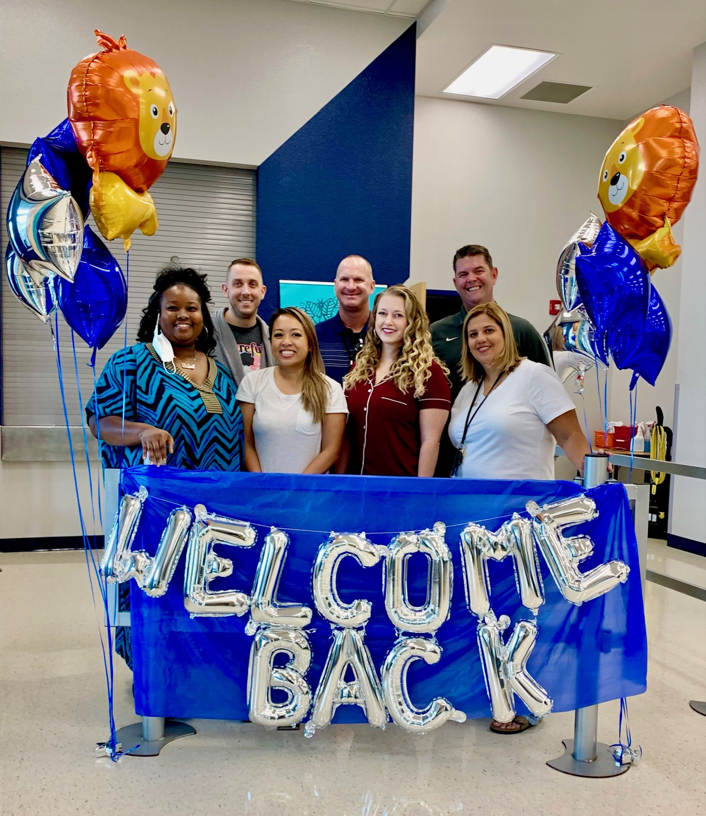
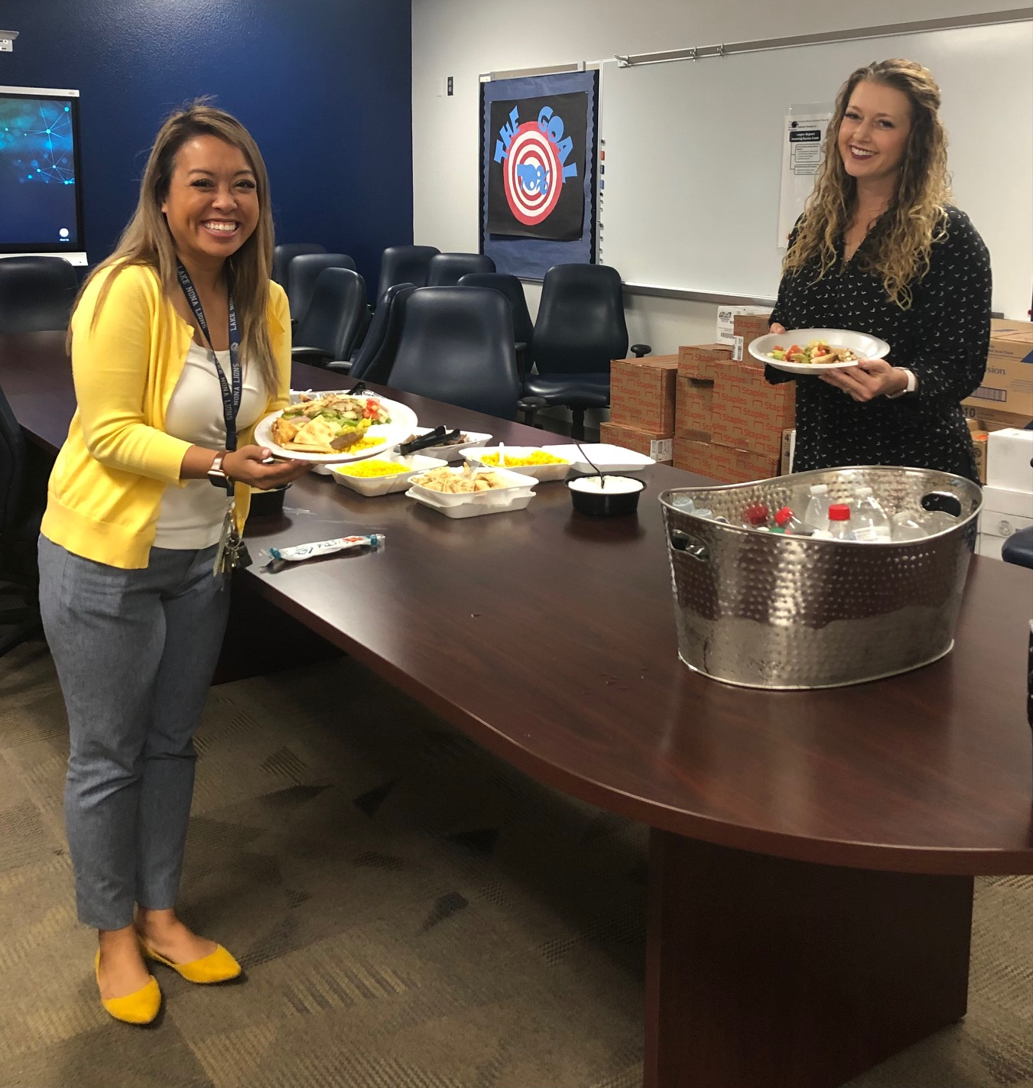
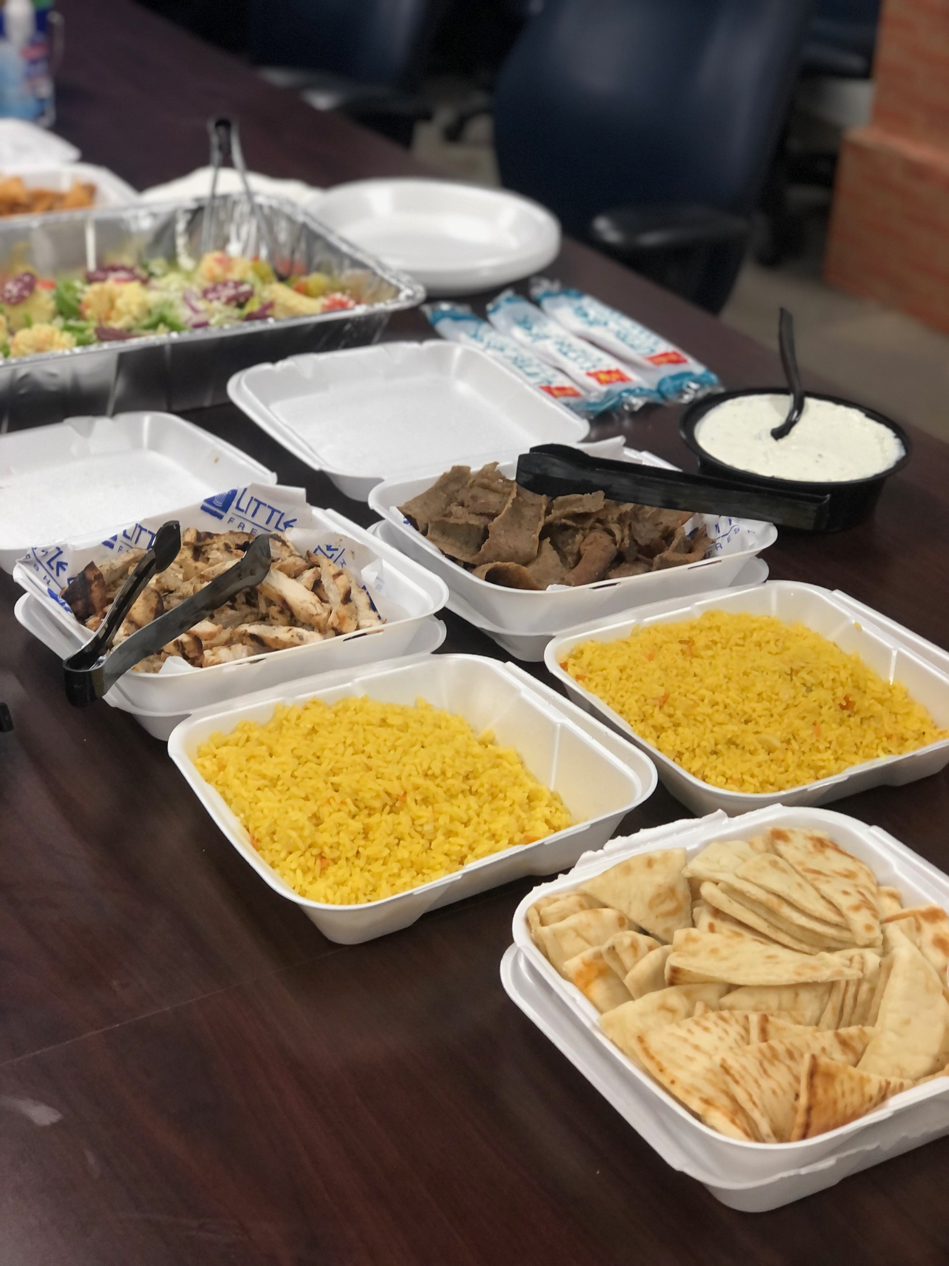
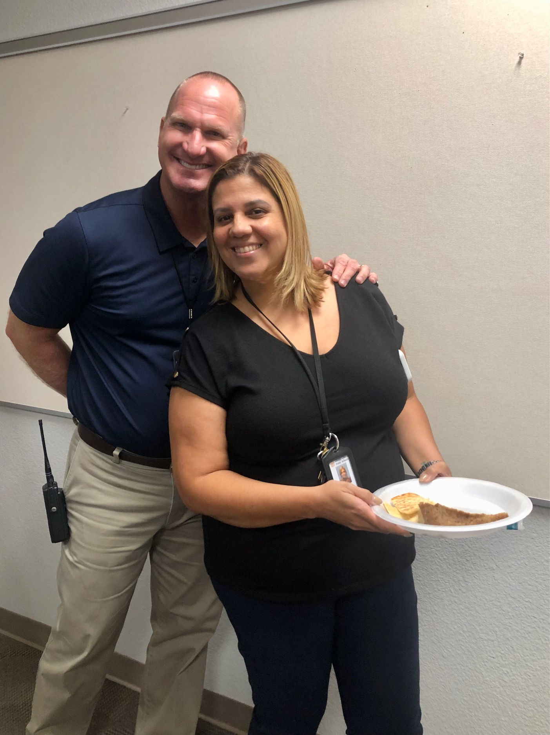
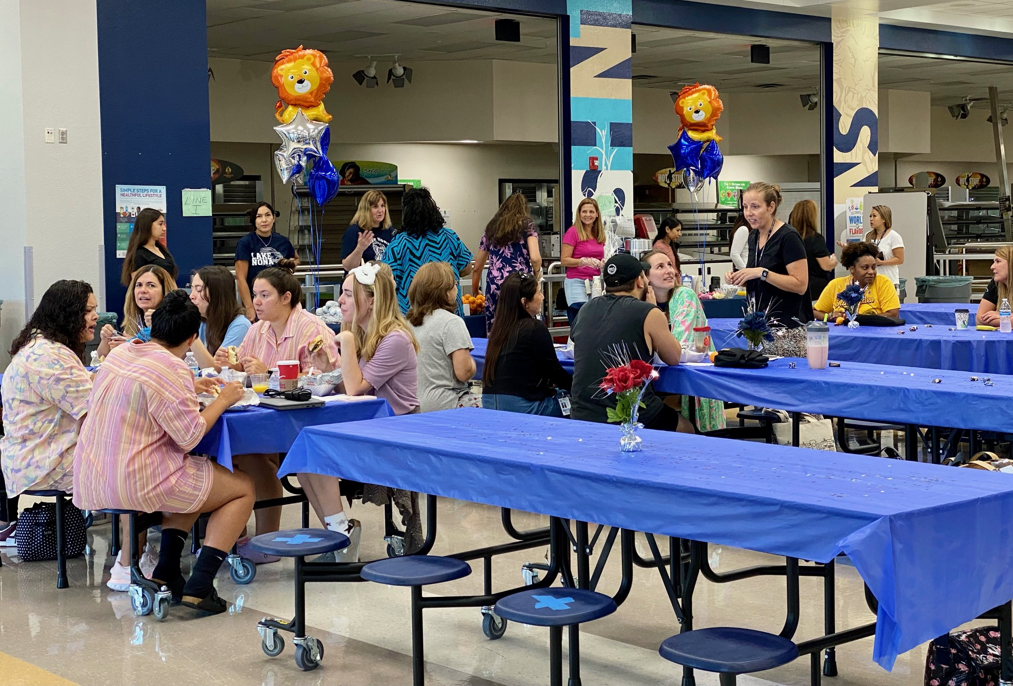
THANK YOU TO OUR VOLUNTEERS AND COMMUNITY PARTNERS!
STAFF
APPRECIATION
July - Leadership Lunch
August - Welcome Back Breakfast

Slide 12
LWL Summer 2022 Recap and Fall Plans
Our PTSA LWL Club has top performing high school students tutor elementary and middle school students in reading or math. These free virtual tutoring sessions are 2 times per week, and the tutors earn volunteer hours towards bright futures.
Summer 2022
We held a 3-week virtual summer camp for elementary and middle school students. Classes on Mon/Wed or Tues/Thur. Good turnout, lots of fun.
We offered 12 subjects such as History, Spanish, Science, Phonics, Story Time, Arts & Crafts, Phonics, Math Games and more.
We also had some of our experienced tutors running private sessions over the summer.
Currently reviewing hours for approval to submit to counselors.
Fall 2022
Meeting with new advisor on Aug 22nd, then first fall board meeting is Sept 7th. (Our student board serves from Jan – Dec so our board members are experienced and can help incoming board members in January.)
We’ll be accepting LWL Club applications from 10-12 grade students by early October. (Freshman are allowed to apply in January/spring.) Watch for more info & ads on the PTSA Instagram, Facebook, and Website.

Slide 13
SAC ELECTIONS (School Advisory Council)
(17) Candidates:
**Kim Carlyle
**Christal Feldman
**Melissa Henry
**Mauricio Movilla
**Carrie Palumbo
**Melissa Pantano
**Kim Tinetti
*Michelle Adamick
Aby Curley
Benish Farooqui
*Rene Griffith
*Ishu Martinez
*Brenda Meadows
Shannon Mitchell
*Erin Reilly
*Ivory Rodante
*Maria Tolosa
** Previous LNHS SAC Members
* Experience with other SAC and/or PTA/PTSA Boards

Slide 14
PTSA STAFF APPRECIATION

Slide 15
STAY CONNECTED
WITH LNHS PTSA
PTSA STAFF APPRECIATION
www.LNHSPTSA.com
www.Facebook.com/LNHSPTSA
SAVE THE DATE
Next General Meeting
Tuesday, September 20, 2022 at 6:30pm

Slide 16
LNHS PTSA August Meeting Topic
MEET THE PRINCIPAL
Q&A Session
Mrs. Nikki Campbell

